Slide 1
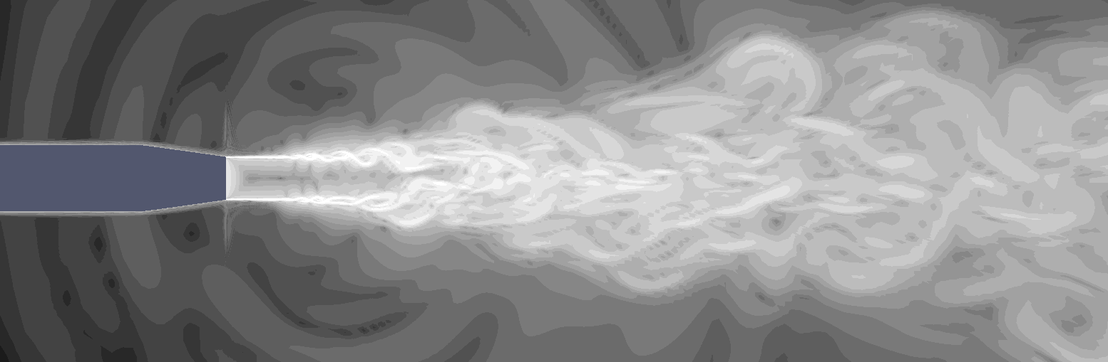
Proposal for round jet test case
Charles Mockett
CFD Software GmbH
charles.mockett@cfd-berlin.com
With support from NTS

Slide 2
Outline (notes)
Intro (pronounced GA / Applications / Partners )
Proposed test case (Shur config / G3 (variation opt.) / BC / Focus on flow – far-field noise optional)
Benchmark data (Bridges / Viswanathan)
Envisaged investigations
Non-zonal GA treatment
Situation for embedded approaches not clear (UniMan?)

Slide 3
Introduction
Hybrid RANS-LES of turbulent jet flows have very pronounced Grey Area
Benchmark test case for jet noise applications
Partners contributing:
CFDB (coordinators)
NLR
NTS
UniMAN
Proposal for concrete test case definition presented
Formulated in collaboration with NTS

Slide 4
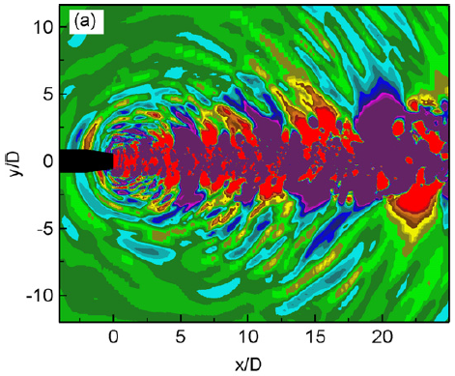
Proposed test case
M = 0.9, unheated, static jet, Re_{D} = 1.1∙10⁶, D = 0.06223 m
Studied extensively by NTS
Shur et al., Journal of Sound & Vibration 330 (2011) 4083-4097
Two-step approach
RANS of jet & plume followed by ILES of plume
Inside of nozzle not meshed: RANS solution imposed at nozzle outlet plane
NTS grids and nozzle plane profiles will be made available to Go4Hybrid partners

Slide 5
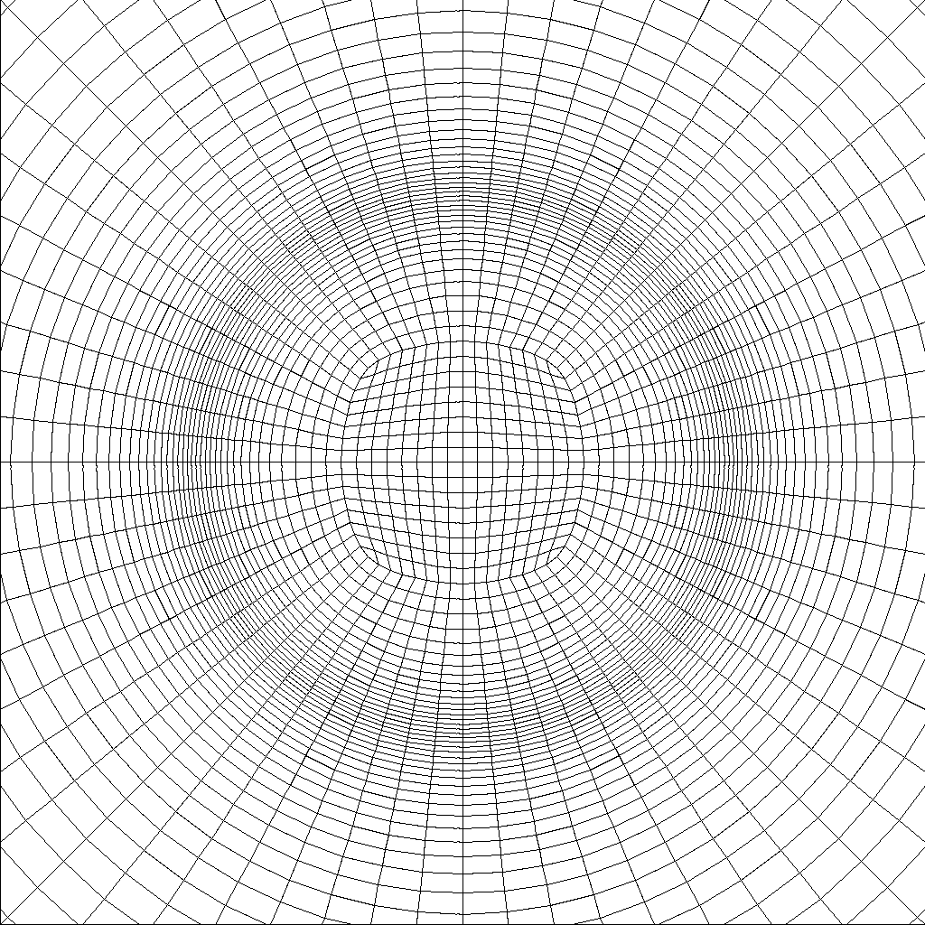
Grids
4 different grid resolutions
Coarse grid shown – hybrid H/O topology
Slice z = 0
Slice x = D

Slide 6
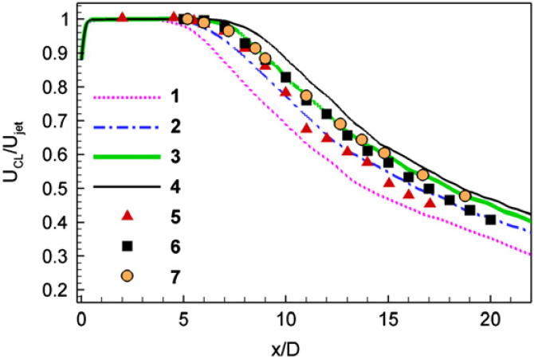
Grids
Grid | Nx | Nr | Nφ | Cell count
G1 | 308 | 81 | 64 | 1.6M
G2 | 515 | 101 | 80 | 4.2M
G3 | 515 | 101 | 160 | 8.4M
G4 | 601 | 158 | 240 | 23M
G3 proposed as mandatory
Gives reasonable results at feasible numerical cost
Computation of grid study encouraged
Robustness of method to insufficient shear layer resolution

Slide 7
Benchmark data
For mean flow / turbulence characteristics (mandatory)
Measured in a number of studies
Significant scatter
“Consensus” data proposed by Bridges
For far-field noise (optional)
Measurements of Viswanathan appear most reliable

Slide 8
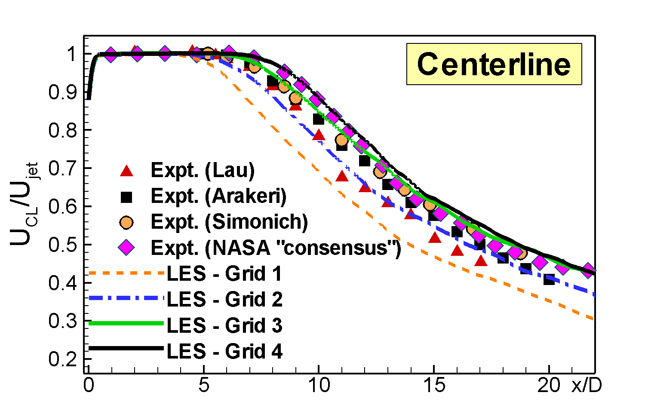
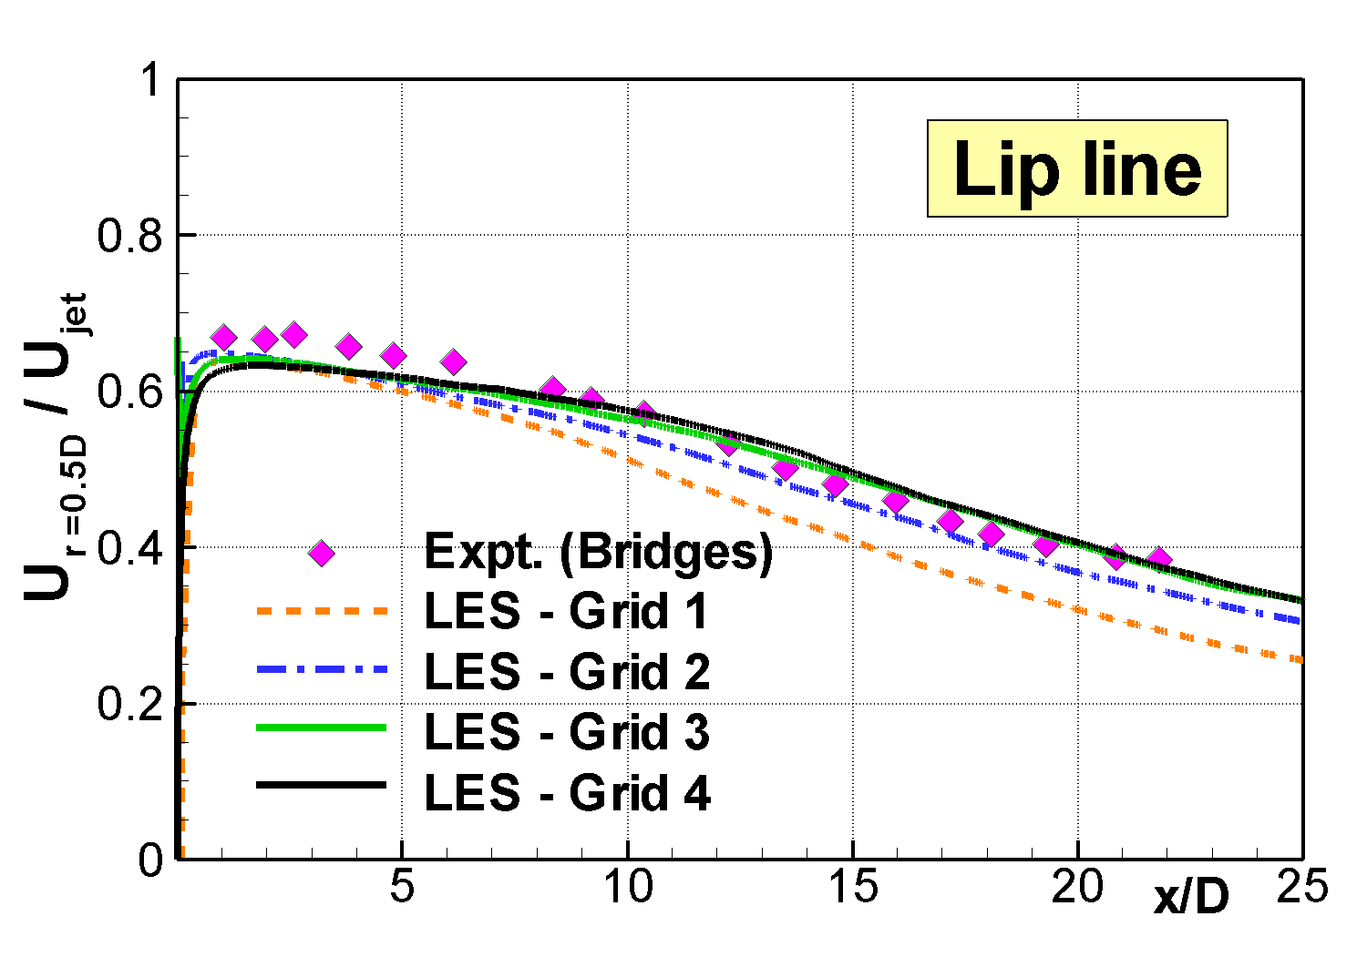
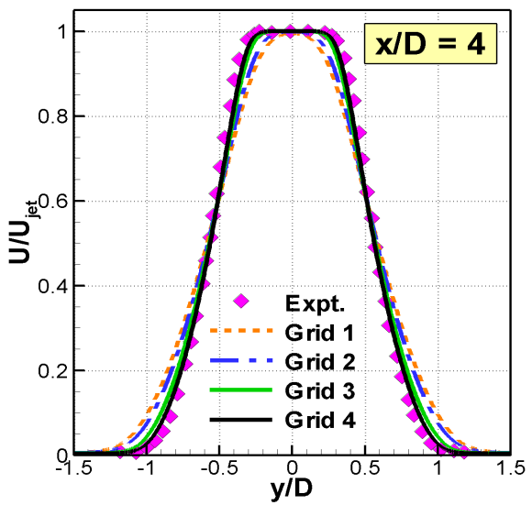
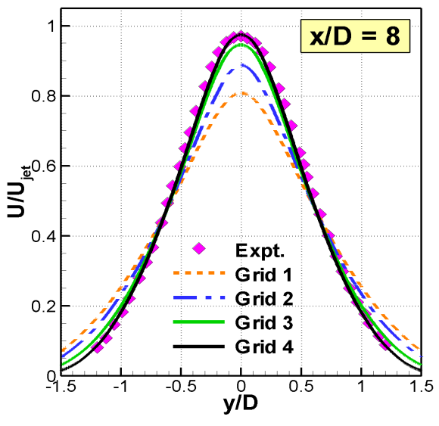
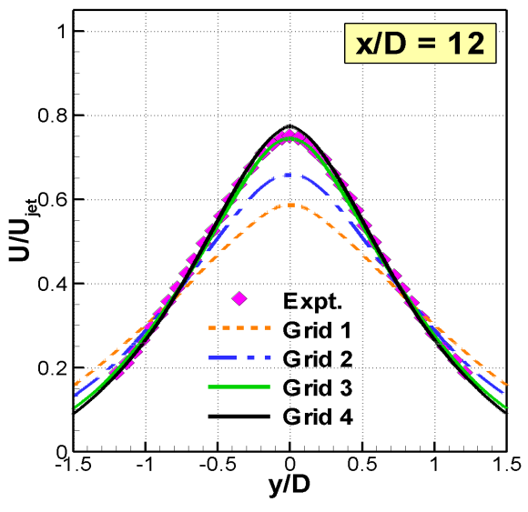
Mean streamwise velocity

Slide 9
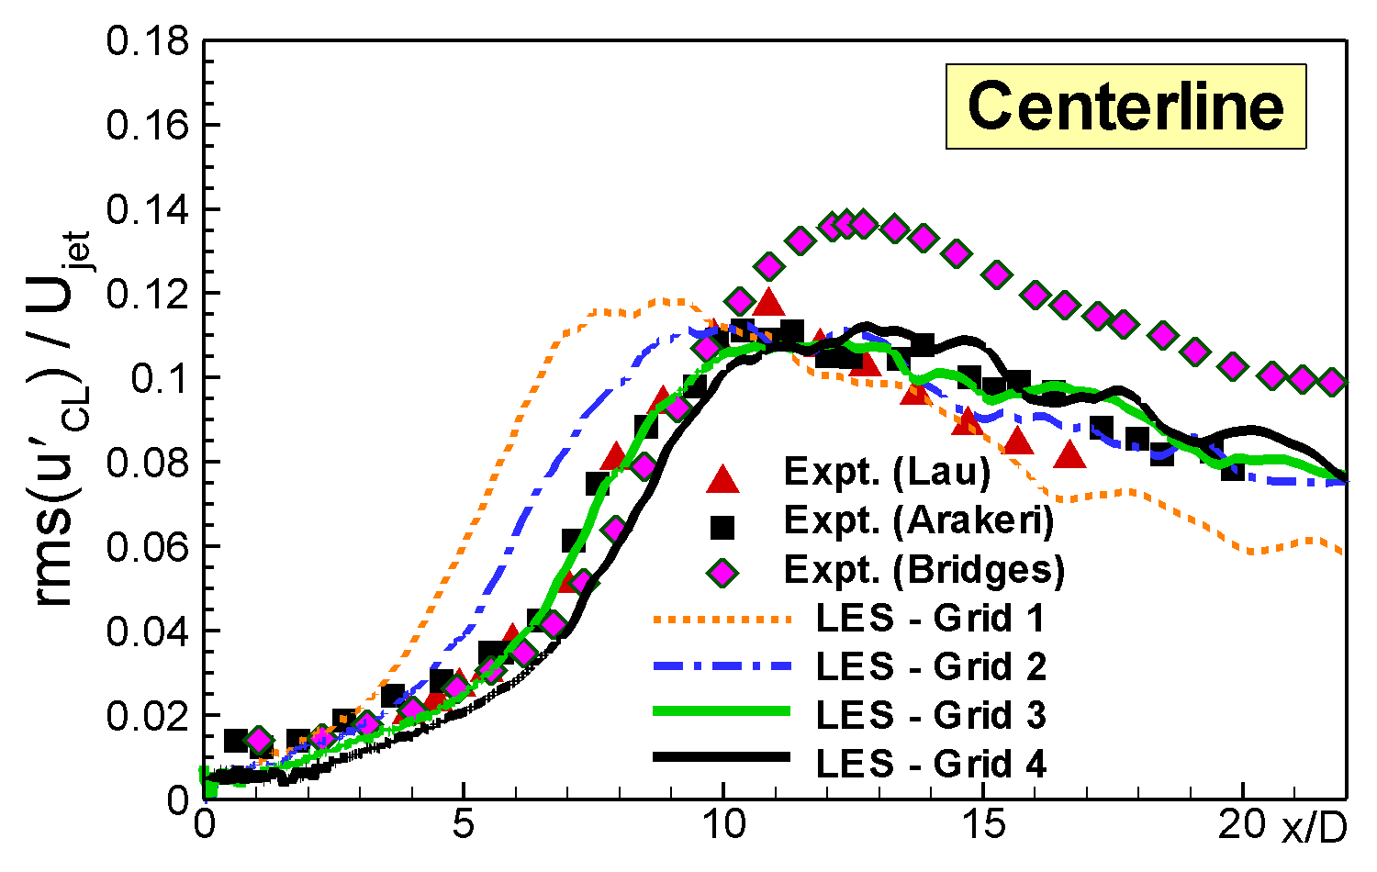
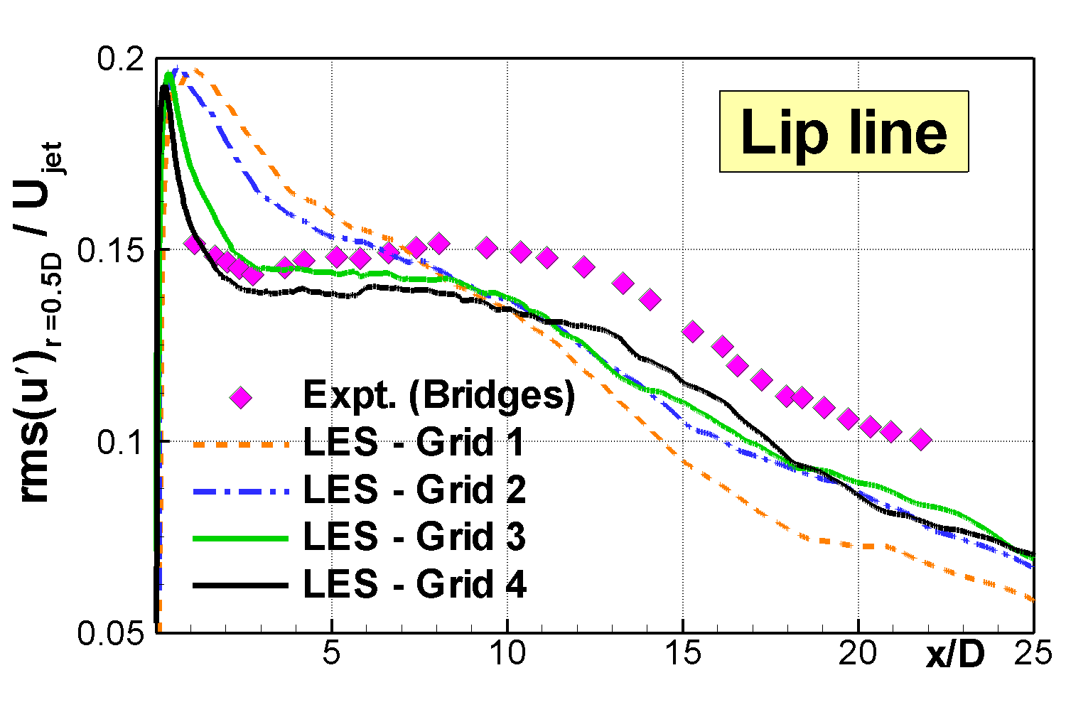
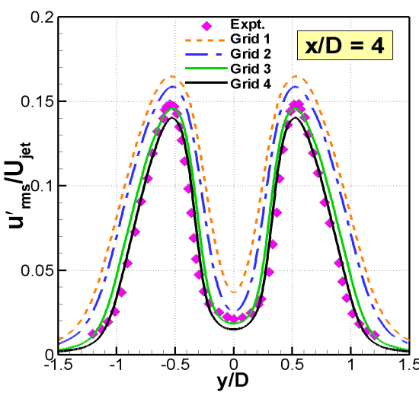
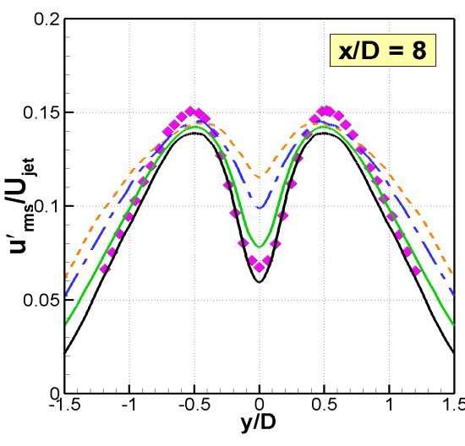
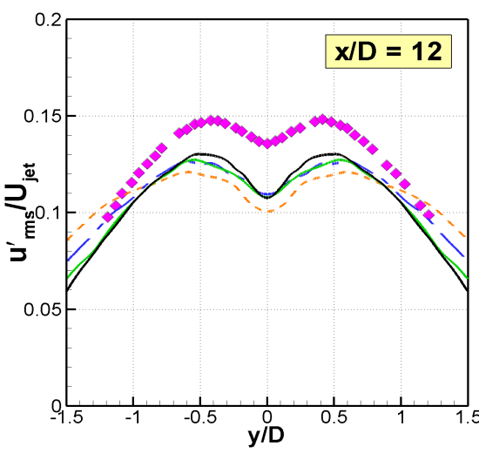
Fluctuations of streamwise velocity

Slide 10
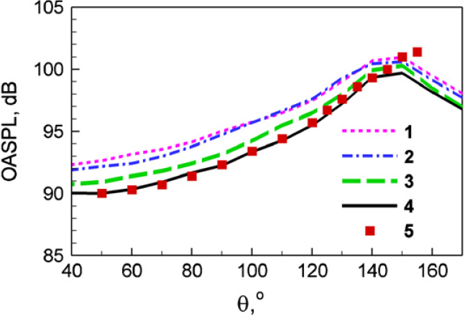
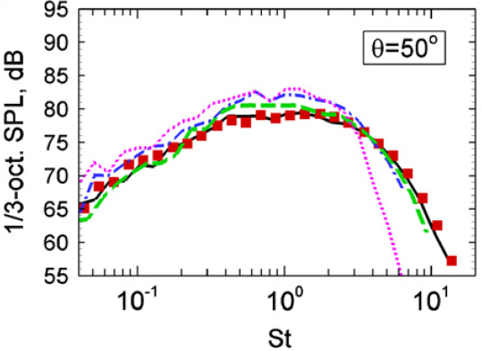
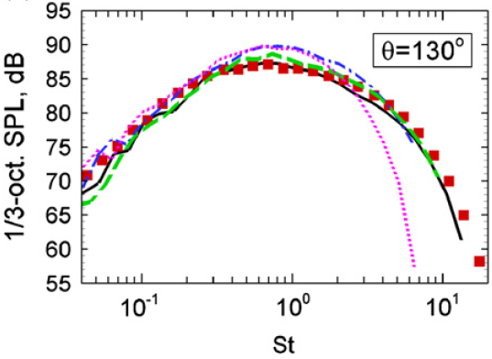
Far field sound

Slide 11
Remarks on method suitability
Non-zonal approaches
Assumes coupled simulation of nozzle and plume
However only plume is meshed
“Emulation” of real situation by imposing RANS solution at nozzle
The test case seems suitable
Embedded approaches
Very thin boundary layer would make WMLES resolution inside nozzle unfeasibly expensive
Negligible turbulence levels in core flow
Questionable whether this case is suitable for embedded approaches
=> UniMAN?

Slide 12
Thank you for your attention
Feedback? Questions?

