Slide 1
Delta Wing with Vortex Breakdown Johan Kok (NLR) and Marian Fuchs (CFDB)
Go4Hybrid Final Workshop, Berlin
28-30/09/2015

Slide 2
Test case definition
NASA delta wing
Chu & Luckring (1996)
65° leading-edge sweep
sharp leading edge
used in VFE-2
stepping Stone in ATAAC
Selected flow condition
vortex breakdown
$α=23°$, $M_{∞}=0.07$, $Re_{mac}={10}^{6}$
Experiment by TU München
includes pressure and velocity fluctuations
Furman & Breitsamter (2008, 2009)

Slide 3
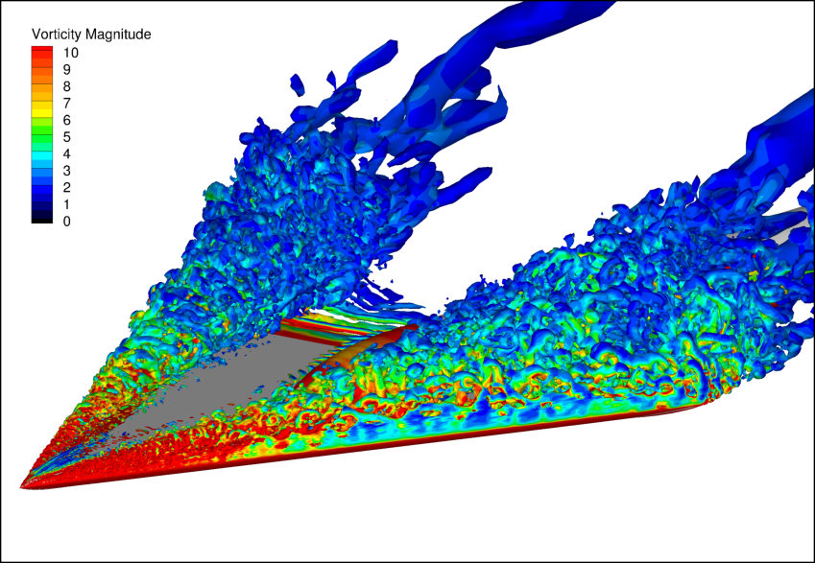
Characterization of flow
Shear layer separates from sharp leading edge and rolls up into primary vortex
At high Reynolds, shear layer becomes unstable and turbulent vortex is formed
At high angle of attack, primary vortex breaks down (high axial velocity in core drops to zero)
Possible secondary, pressure-induced separation (between primary vortex and leading edge)
Grey areas:
shear layers emanating from leading edges
initial vortex near apex

Slide 4
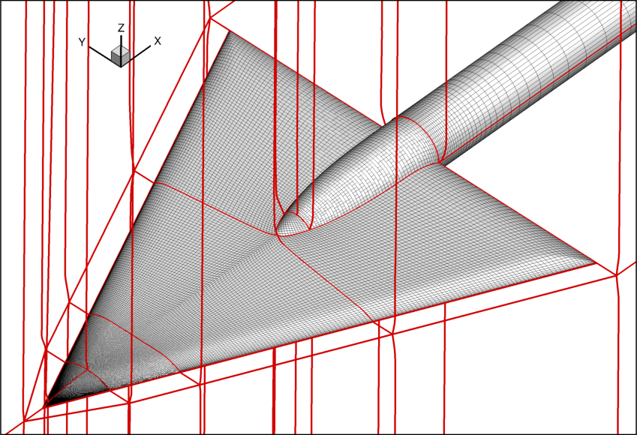
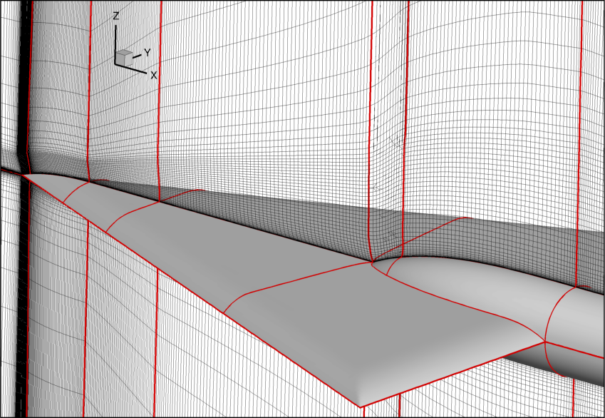
Grids
Common multi-block structured grid (from ATAAC)
6.3 Mcells (mandatory) + 21.4 Mcells (fine)
mesh size ≈ 0.003 to 0.011c_{mac}
far field: 3 root chords
conical structure: refined towards apex (learned in ATAAC)

Slide 5
Available reference data
Experiment of TU München:
Steady surface pressure at five chord stations: x/c_{r} = 0.2, 0.4, 0.6, 0.8, and 0.95
Unsteady surface pressure at four chord stations: x/c_{r} = 0.4, 0.6, 0.8, and 0.95
Stereo-PIV (mean velocity field) at five chord stations: x/c_{r} = 0.2, 0.4, 0.6, 0.8, and 0.95
HWA (fluctuating velocity field) at three chord stations: x/c_{r} = 0.4, 0.6, and 0.8
(Oil flow visualization)
Experimental data provided by Christian Breitsamter (TU München)

Slide 6
Computations performed
CFDB:
baseline: standard SA-DDES + Δ_{max}
GAM: SA-σ-DDES + ${\tilde{Δ}}_{ω}$ (GAM)
2nd-order blended central/upwind scheme
NLR:
baseline: standard SST-DDES
GAM: DX-LES + HPF + stochastic backscatter SGS model
4th-order low-dispersion skew-symmetric finite-volume method
Common
mandatory grid
2nd-order implicit time integration
$Δt=3.75⋅{10}^{−4}$ CTU (convective CFL $≈1/8$)
1300 time steps per period of dominant frequency (St $≈2$)
transient about 7 CTU; statistics about 15 CTU

Slide 7
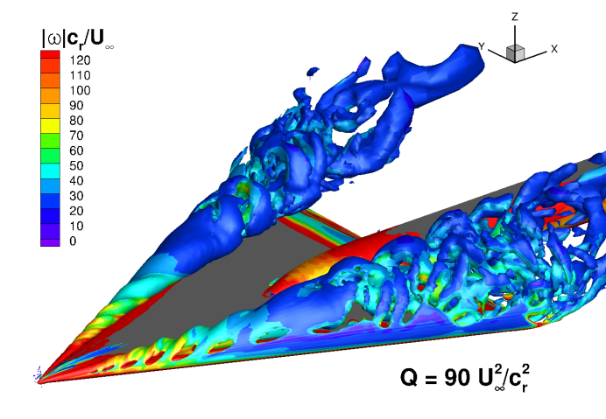
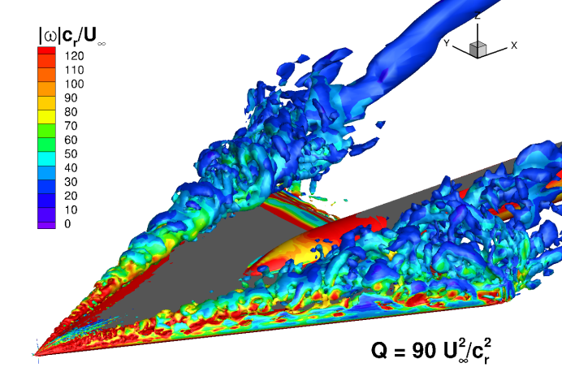
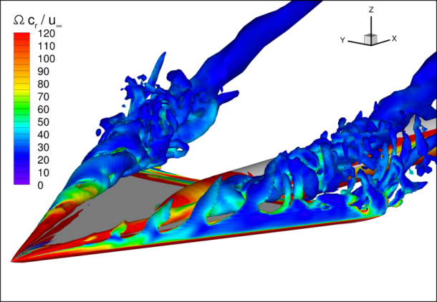
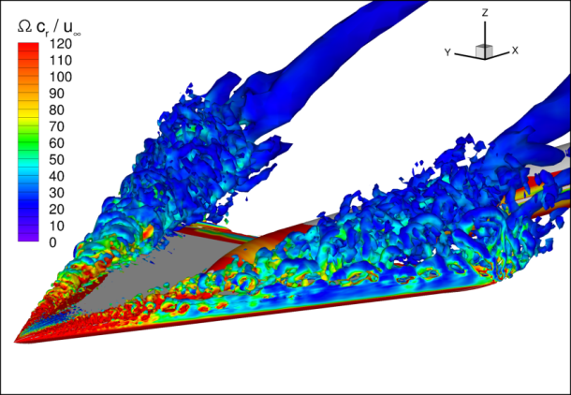
Instantaneous vortical structures
CFDB
steady helical structures
unsteady fine structures
SA-DDES + Δ_{max}
SA-σ-DDES + ${\tilde{Δ}}_{ω}$
NLR
SST-DDES
HPF DX-LES

Slide 8
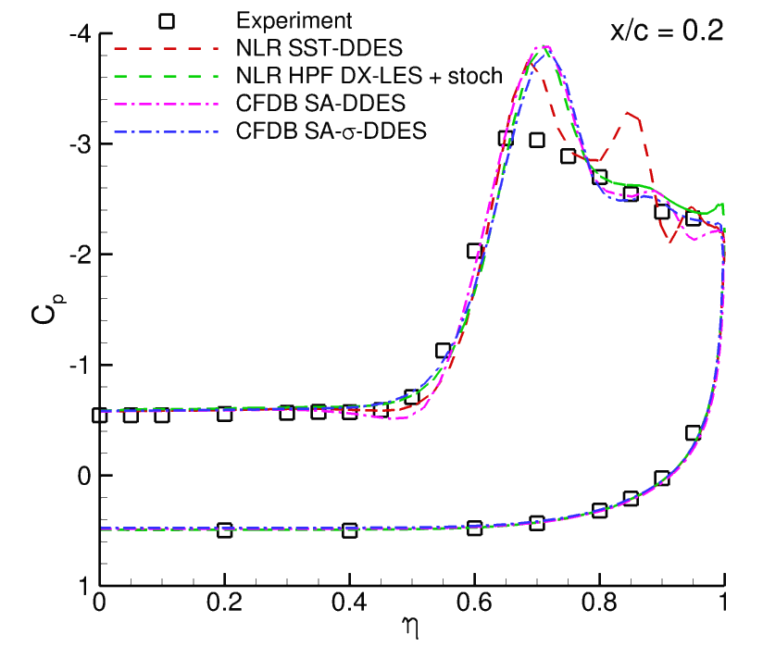
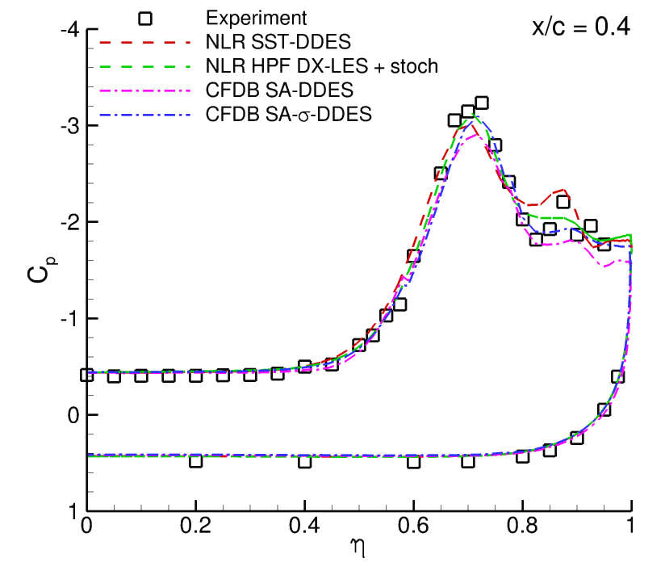
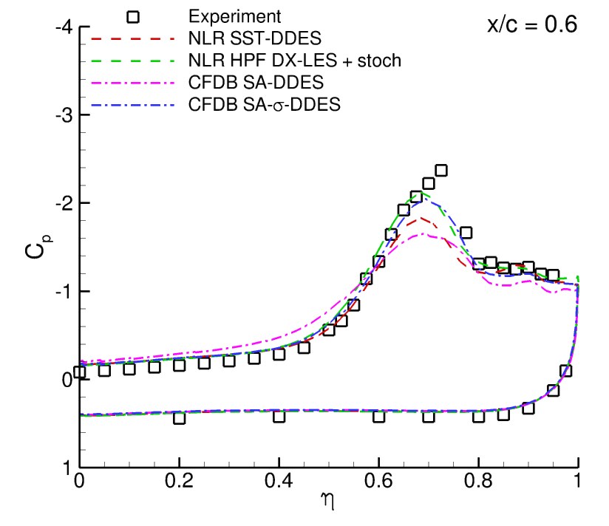
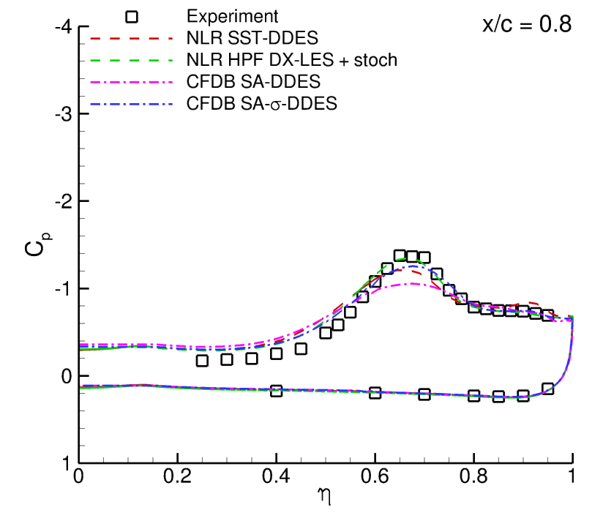
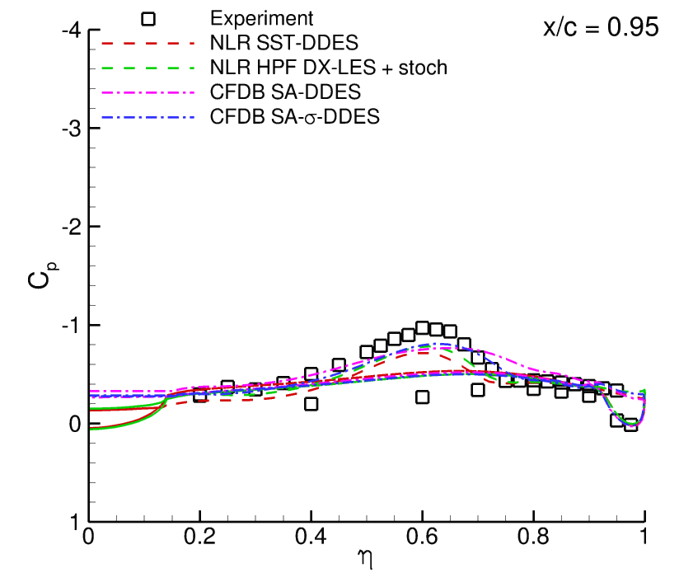
Mean pressure coefficient
GAM methods:
improved suction peak of main vortex

Slide 9
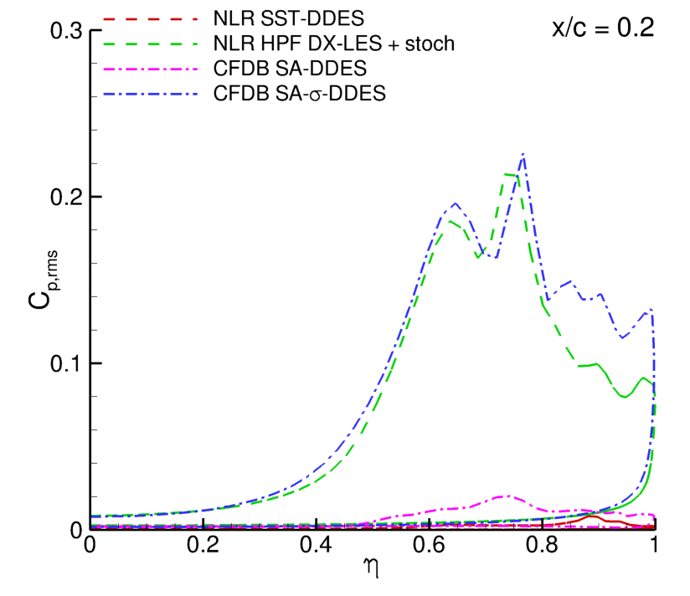
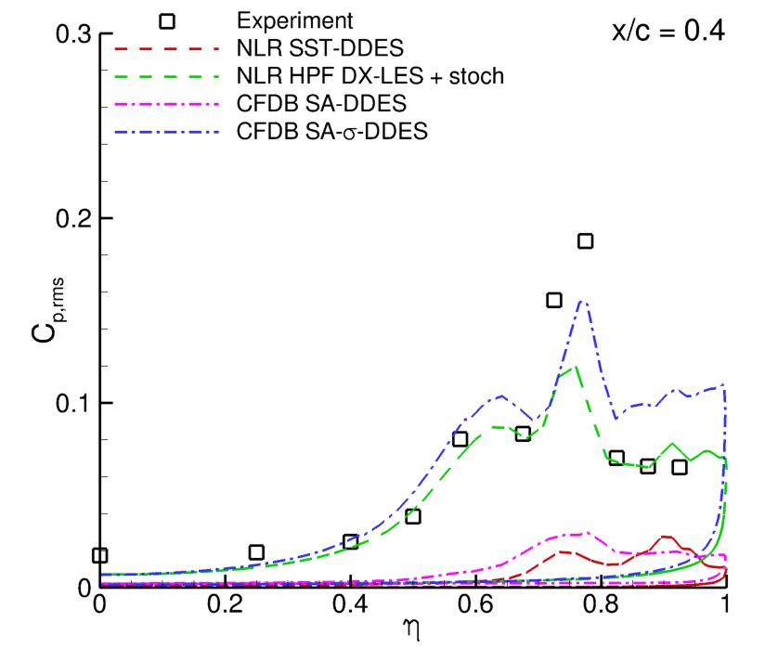
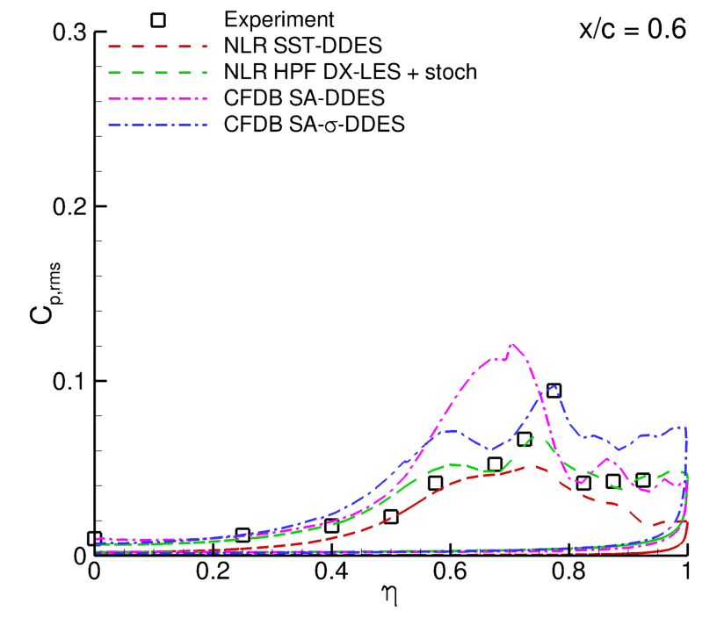
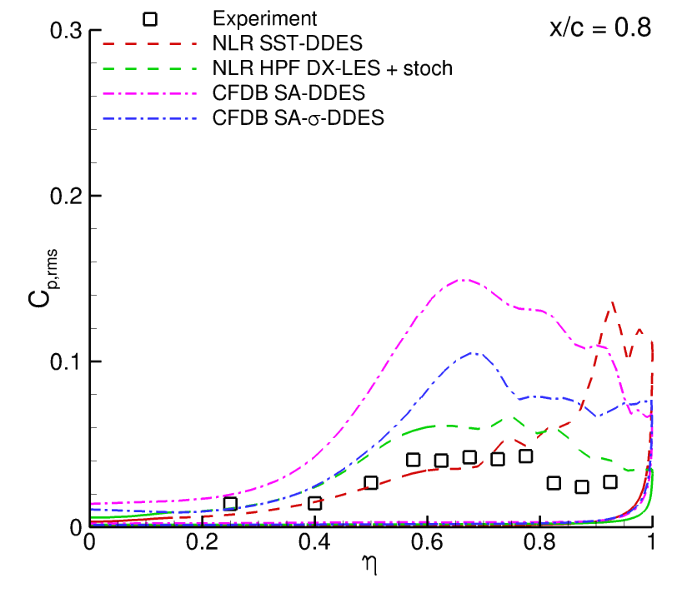
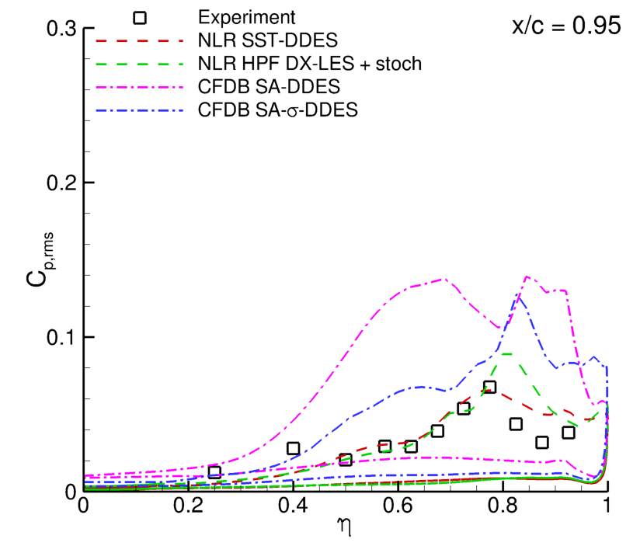
RMS of pressure coefficient
GAM methods:
improved pressure fluctuations

Slide 10
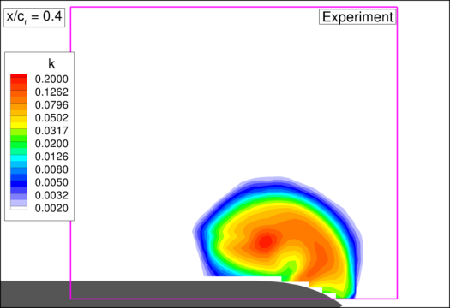
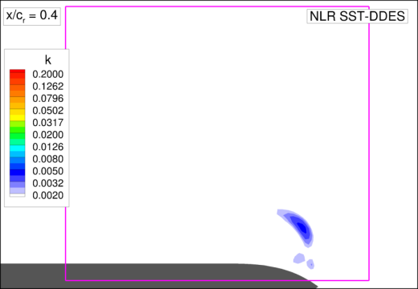
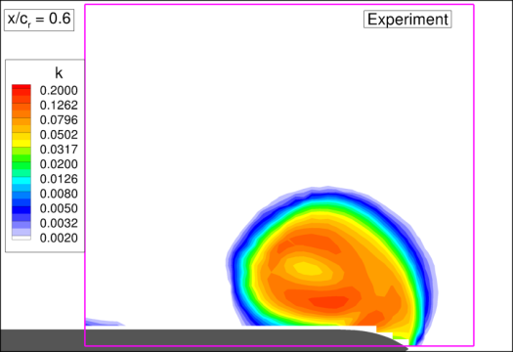
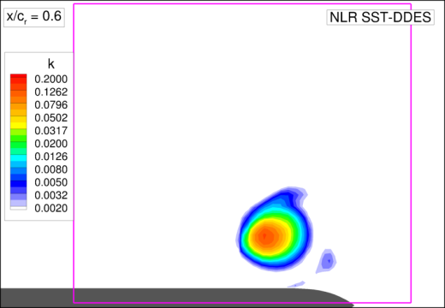
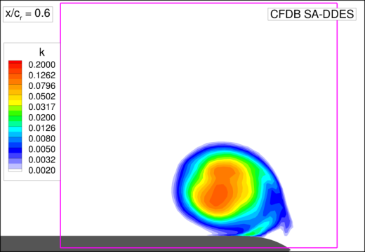
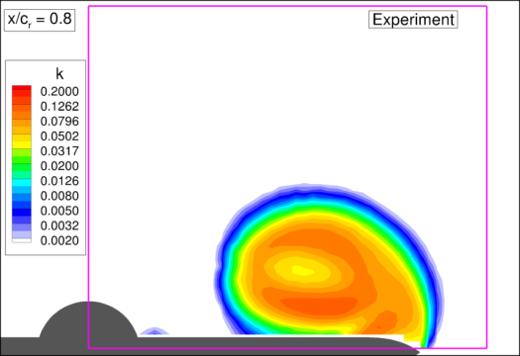
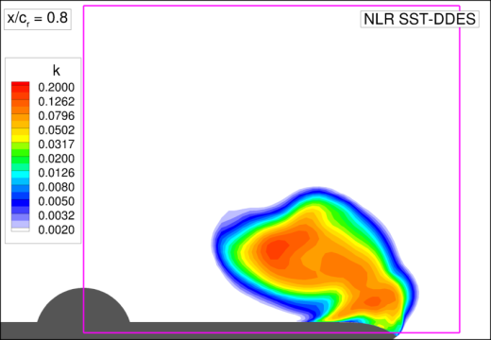
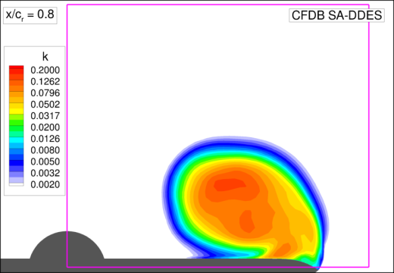
Resolved turbulent kinetic energy – baseline methods
no resolved turbulence
x/c = 0.4
x/c = 0.6
x/c = 0.8
Experiment (HWA)
NLR SST-DDES
CFDB SA-DDES

Slide 11
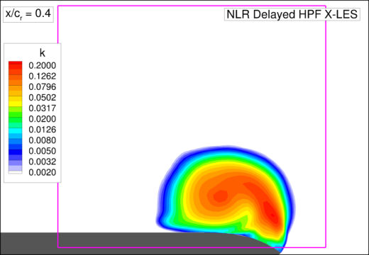
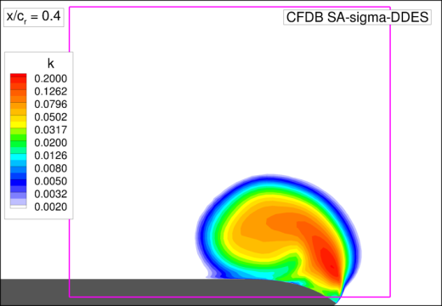
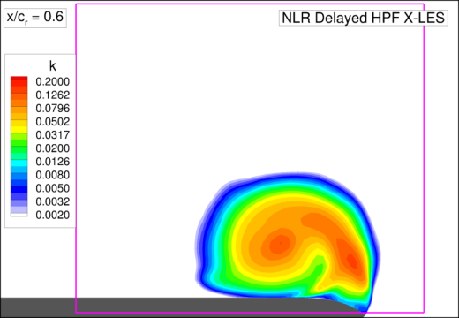
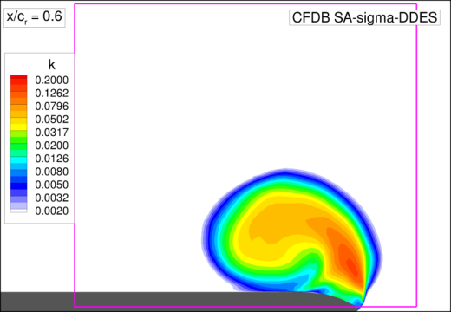
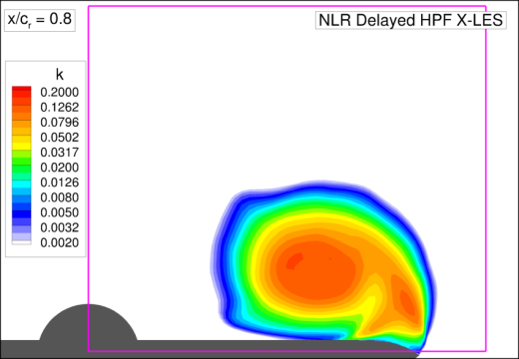
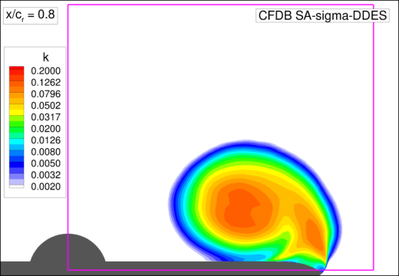
Resolved turbulent kinetic energy – GAM methods
improved resolved turbulence
x/c = 0.4
x/c = 0.6
x/c = 0.8
Experiment (HWA)
NLR HPF DX-LES
CFDB SA-σ-DDES

Slide 12
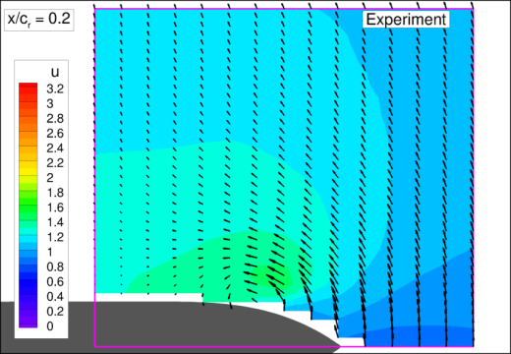
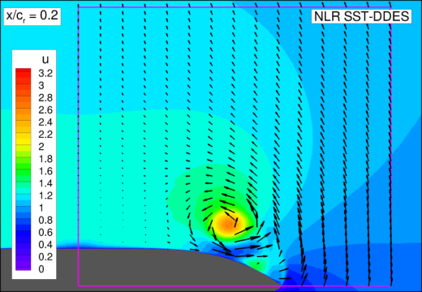
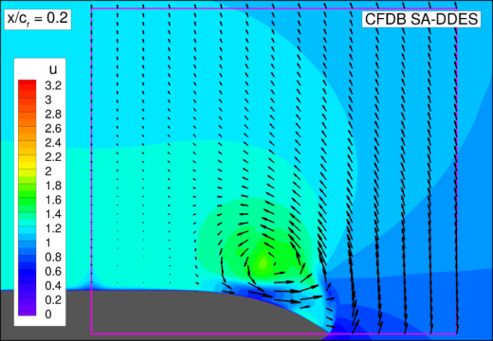
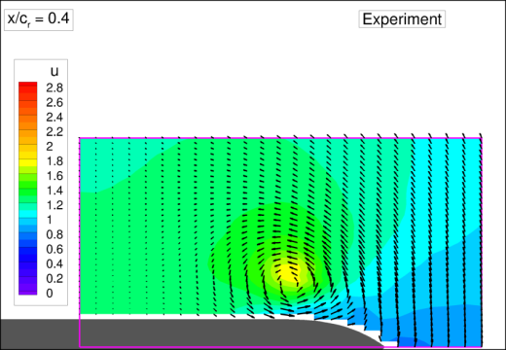
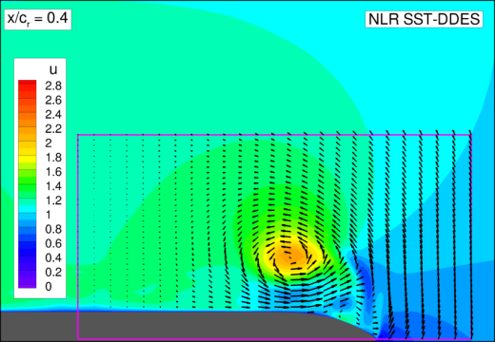
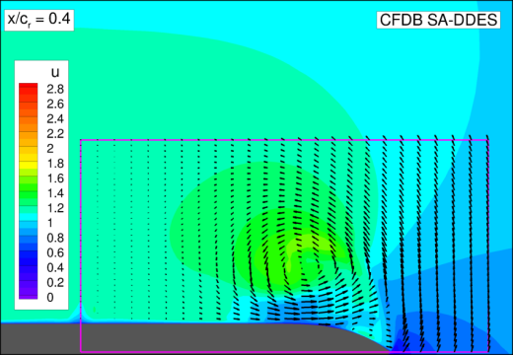
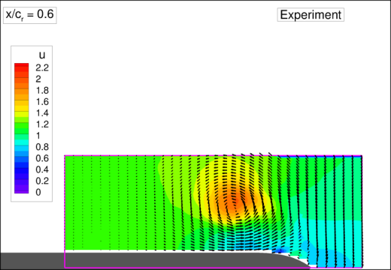
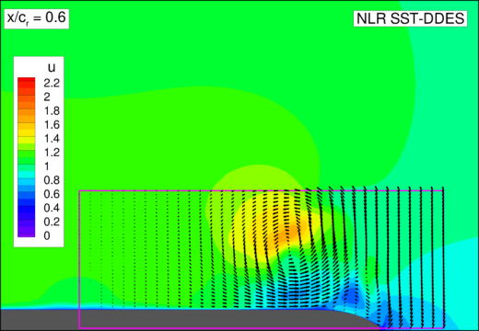
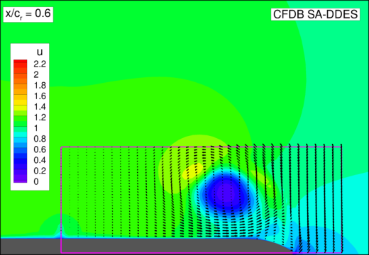
Time-averaged velocity field – baseline methods
vortex higher/stronger
x/c = 0.2
x/c = 0.4
vortex breakdown too early
x/c = 0.6
Experiment (PIV)
NLR SST-DDES
CFDB SA-DDES

Slide 13
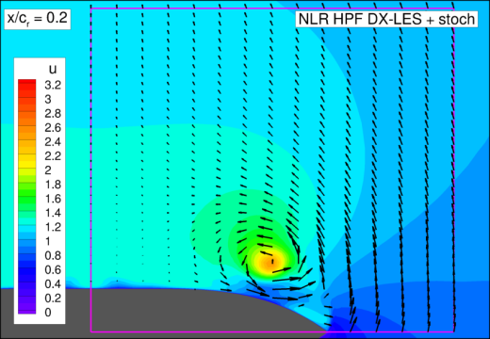
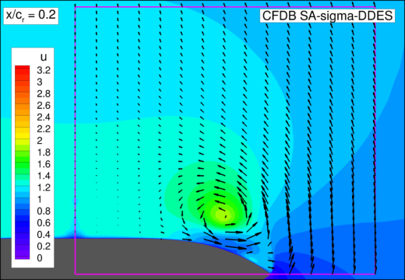
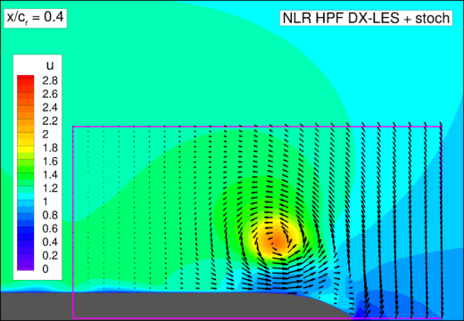
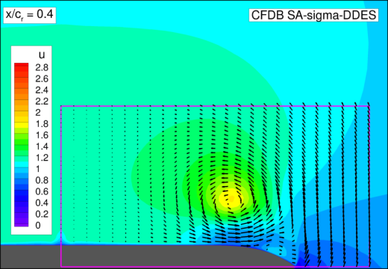
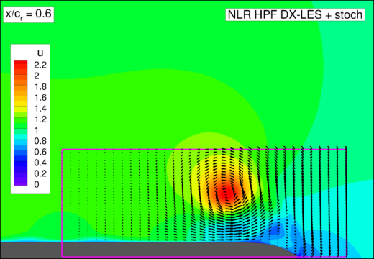
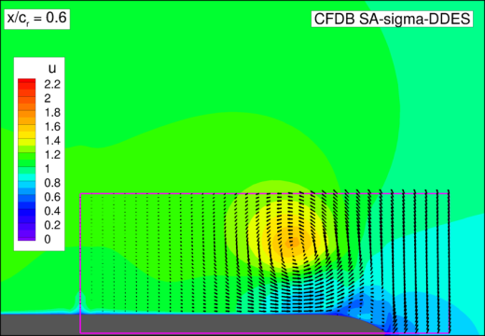
Time-averaged velocity field – GAM methods
x/c = 0.2
x/c = 0.4
vortex breakdown delayed
x/c = 0.6
Experiment (PIV)
NLR HPF DX-LES
CFDB SA-σ-DDES

Slide 14
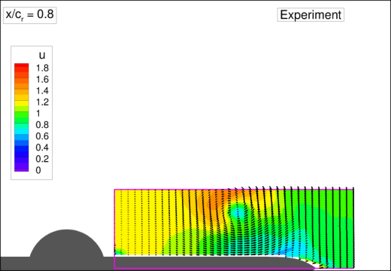
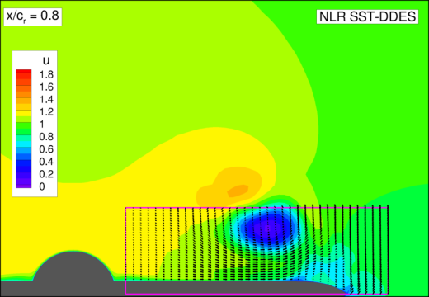
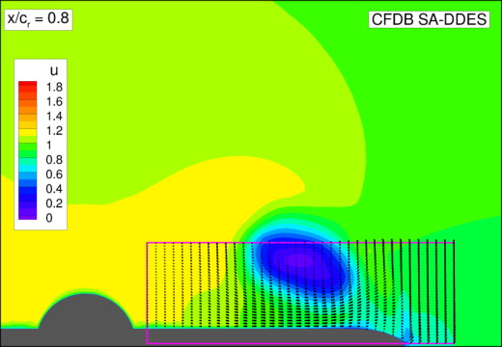
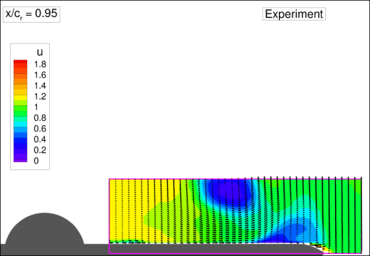
Time-averaged velocity field – baseline methods
vortex breakdown too early
x/c = 0.6
vortex breakdown
x/c = 0.8
x/c = 0.95
Experiment (PIV)
NLR SST-DDES
CFDB SA-DDES

Slide 15
Time-averaged velocity field – GAM methods
vortex breakdown delayed
x/c = 0.6
vortex breakdown
x/c = 0.8
x/c = 0.95
Experiment (PIV)
NLR HPF DX-LES
CFDB SA-σ-DDES

Slide 16
I2 Delta wing – Conclusions
GAM methods give very similar results
CFDB (SA-σ-DDES + ${\tilde{Δ}}_{ω}$)
NLR (DX-LES + HPF + stochastic backscatter SGS model)
Strong improvement by GAM methods, in particular in terms of levels of pressure fluctuations and resolved turbulence
As a result, GAM delays vortex breakdown Breakdown location closer to PIV measurements

Slide 18
Experiment: Time-averaged velocity field and turbulent kinetic energy
x/c = 0.4
early vortex breakdown induced by HWA?
x/c = 0.6
vortex breakdown
x/c = 0.8
PIV: mean u
HWA: mean u
HWA: k

