Slide 1
DLR: Review of state-of-the-art
Axel Probst, Silvia Reuß, Dieter Schwamborn
Go4Hybrid Kick-Off meeting, Berlin, 10.10.2013

Slide 2
DLR Codes to be used in Go4Hybrid
generally unstructured Finite-Volume solvers
2nd-order in space and time
TAU:
  compressible, focused on external aerodynamics
  broad application in aeronautics industry and academia
  common SRS models (DES variants, SAS, PANS) and DLR‘s ADDES, initial SEM implementation, stochastic forcing, …
THETA:
  incompressible, mainly focused on internal flows
  much faster for unsteady low-Mach-number flows
  SRS implementations currently brought „in line“ with TAU status
idea: use THETA for basic developments and transfer them into TAU

Slide 3
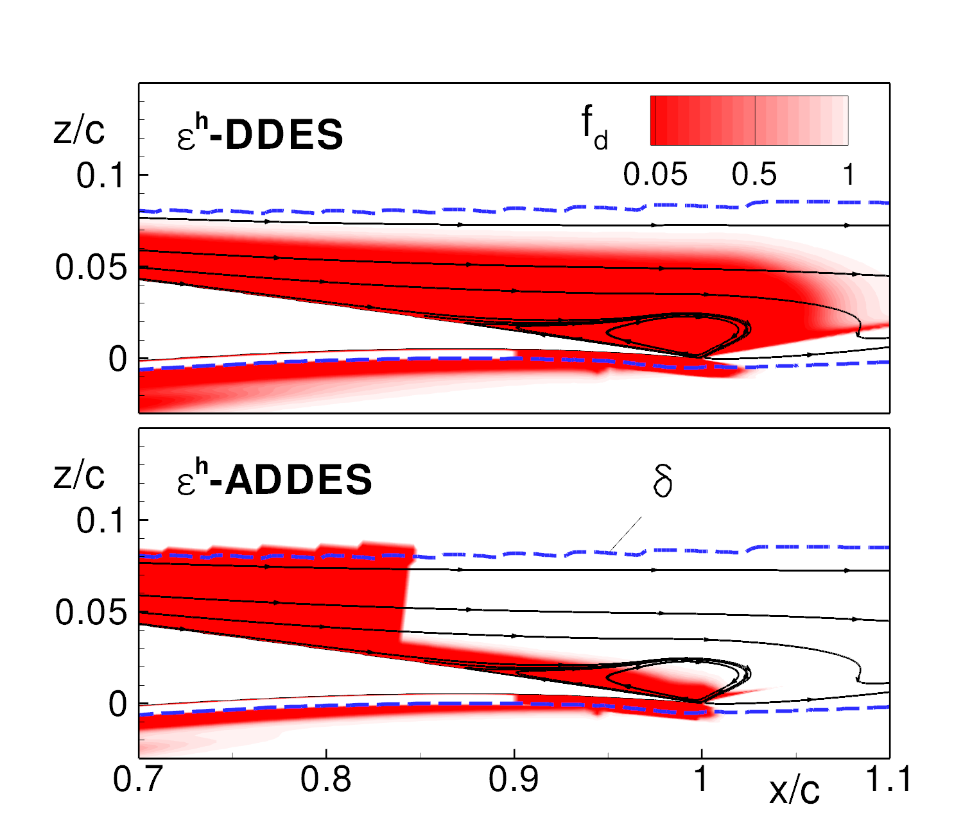
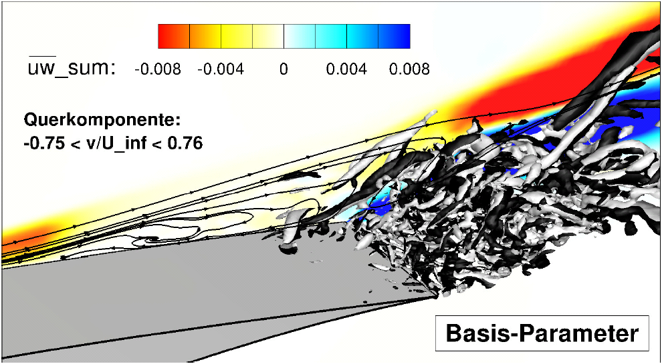
DLR experience with the grey area in SRS
main flow-/modelling classes identified:
Geometry-induced separation,
e.g. backward-facing step:
  “non-zonal” mitigation, e.g. stochastic forcing,
  special filter definitions, high-pass filtering, …
Pressure-induced separation from smooth
surfaces, e.g. HGR-01 tail-plane airfoil:
  “embedded” method, i.e. synthetic turbulence
ADDES:
red: RANS
white: LES

Slide 4
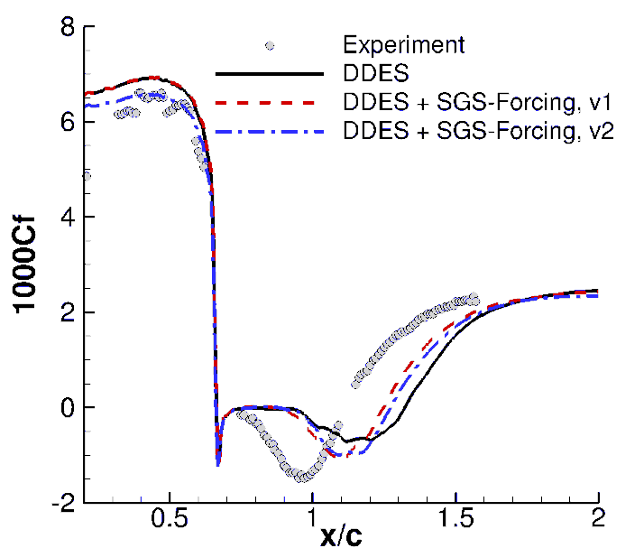
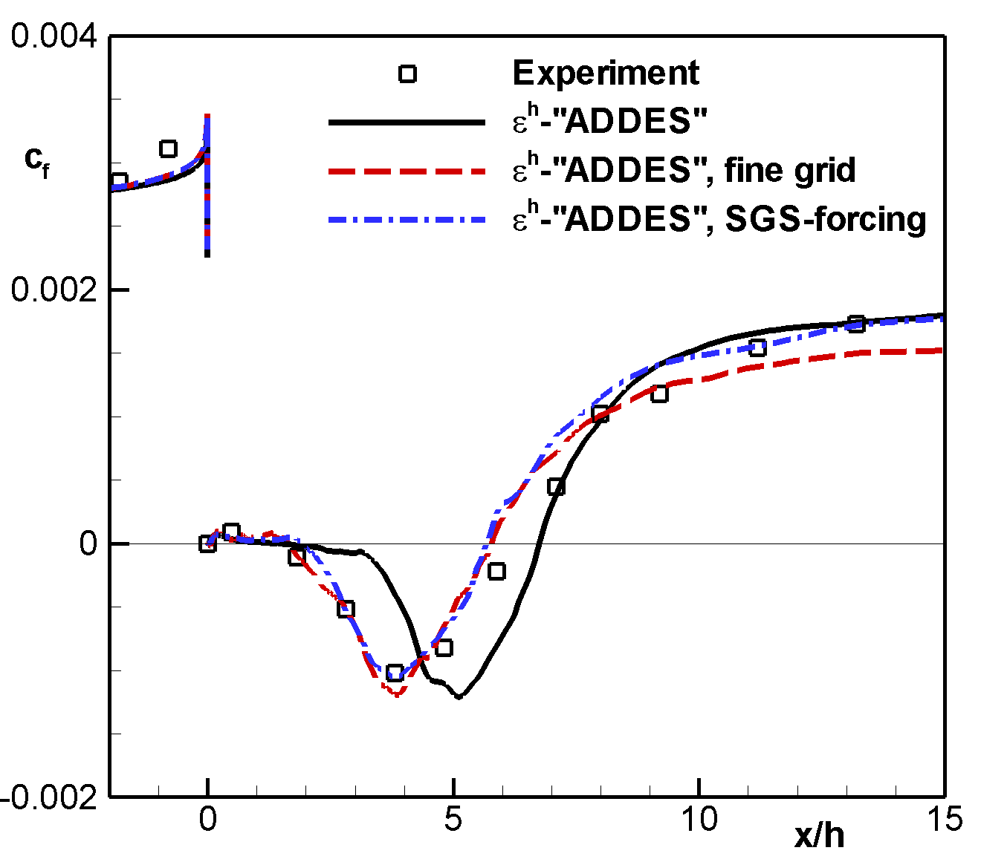
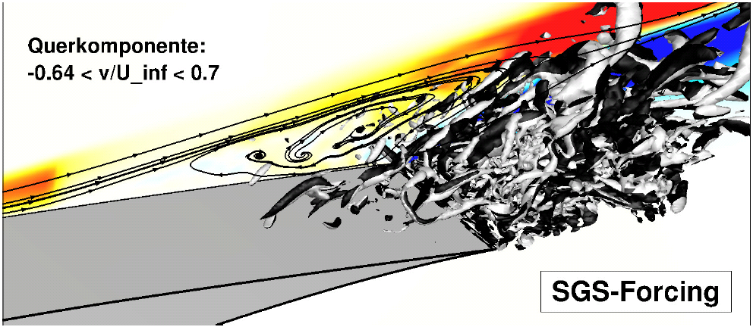
Previous DLR work on grey area mitigation
Stochastic forcing
random forcing of (scalar) eddy viscosity (SA-, SST-DDES)
and full Reynolds stress tensor (ε^{h}-RSM-DDES)
different stochastic distributions tested with TAU
success strongly depends on flow problem (as expected):
Shallow separation from
smooth surface (airfoil): ↓
Medium separation from
smooth surface (2d hump): →
Large separation
from step (BFS): ↑

Slide 5
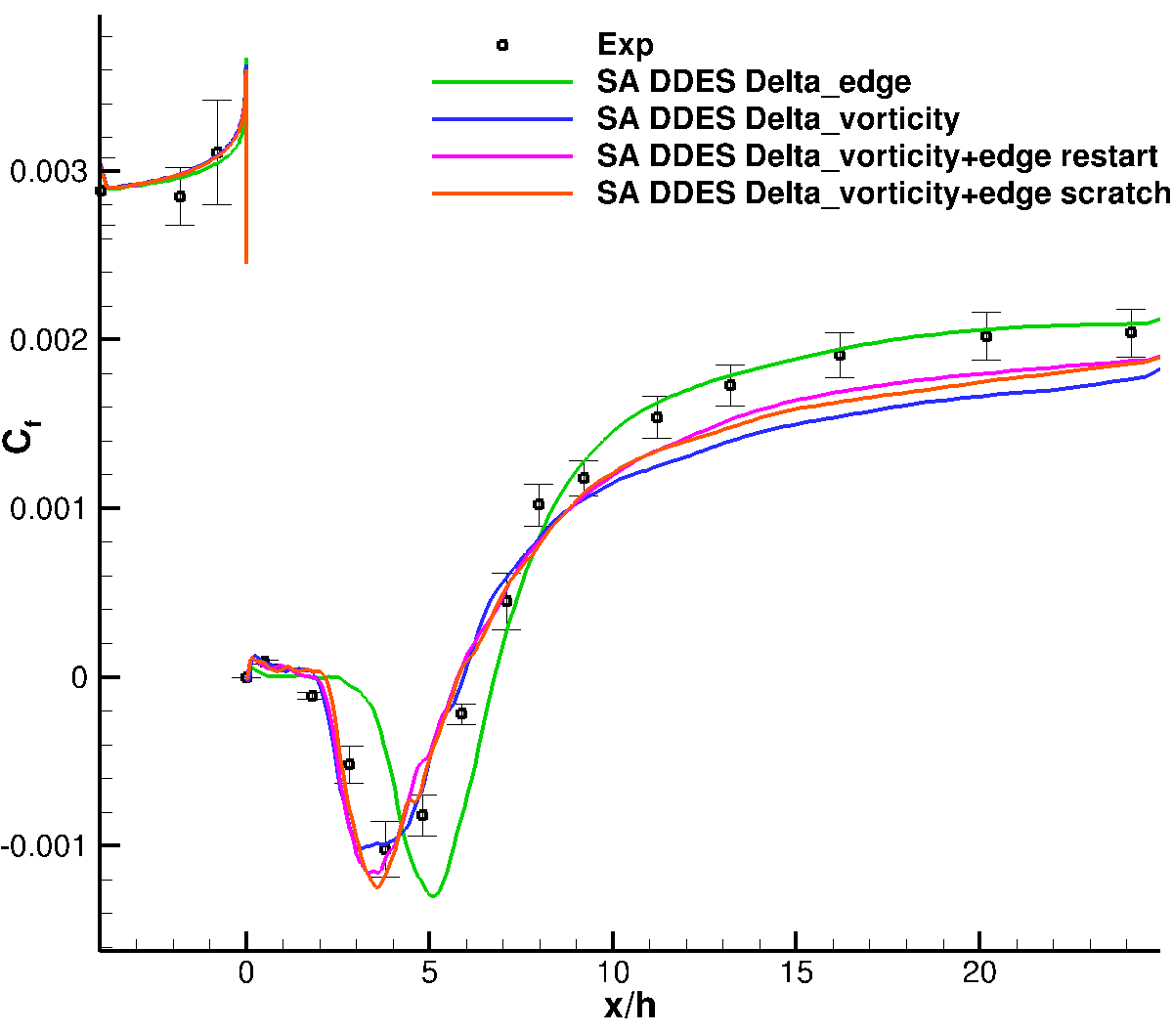
DLR work on grey area mitigation
Modified filter definition
classical DES-filter definition (maximum „edge“) replaced by „vorticity“ filter (as proposed by S. Deck):
tested for backward-facing step:
  in whole LES region
  in separated region only
  (up to x/h = 6)
clearly reduces grey area, but
no full c_{f} recovery downstream
$$Δ_{vort} =\sqrt{N_{x}^{2}Δ_{y,max}Δ_{z,max}+N_{y}^{2}Δ_{x,max}Δ_{z,max}+N_{z}^{2}Δ_{x,max}Δ_{y,max}}$$

Slide 6
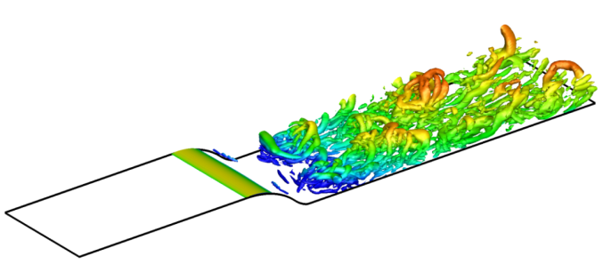
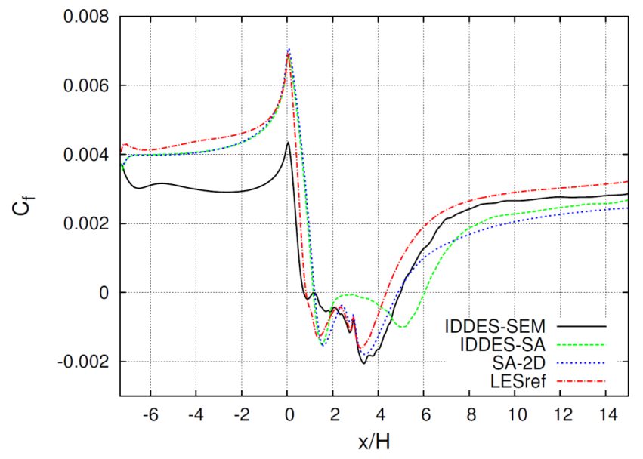
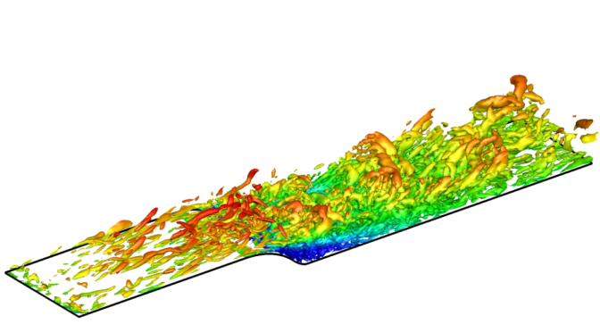
Previous DLR work on grey area mitigation
Synthetic turbulence (RANS -> LES)
initial implementation of Synthetic Eddy Method (Jarrin, 2006) in TAU
few tests on generic flows so far:
  2d channel flow (LES, SA-IDDES)
  rounded step with separation (SA-IDDES):
open issues:
  strong p/ρ-disturbances due to inherent divergence
  seamless integration in RANS/LES (plane location, RANS input data)
IDDES
Q=850 1/s²
IDDES+SEM

Slide 7
DLR work plan in Go4Hybrid
contributions in WP 3.1, 3.2 and 4.2
basic model development / implementations:
  generalize SEM framework for other methods (e.g. DF-SEM, NTS)
  insert synthetic turbulence at RANS/LES interface given by ADDES
  combination with automatic grid adaptation in LES regions
Test cases considered:
Flat plate (F.1)
  basic tests of synthetic turbulence implementations in TAU/THETA
  different turbulence generators and RANS „input“ models (up to RSM)
2D hump flow (I.4)
  basic tests of ADDES + synthetic turbulence + grid adaptation
3-element high-lift airfoil (I.3, coordinated by DLR)
  test full approach in consecutive steps: LES only on flap, LES only in slat cove, final combined simulation (if time permits)

Slide 8
DLR will extend its current implementation of the Algebraic Delayed DES (ADDES) in the DLR-TAU code by
synthetic turbulence generators and perform a detailed assessment of the methods for the fundamental test
case F.1. The ADDES provides an automatic placement of the RANS/LES interfaces near separation and
reattachment points via algebraic relations, but they can also be manually set at a desired location in attached
flows, e.g. within the flat-plate boundary layer of F.1.
In this work, a recent implementation of the “Synthetic-Eddy Method”, SEM (Jarrin et al., 2006), which is so-far
restricted to inflow boundaries, will be generalized to be applicable to the wall-normal planes in the flow field as
provided by ADDES. So far, the ADDES reduces to conventional DES in the LES region, but it will be extended
by wall-modelled LES capabilities based on the Improved DDES (IDDES) model functions. Moreover, TAU’s
grid-adaptation method, which is able to locally refine both unstructured (tetrahedral) and structured (hexahedral)
parts of hybrid grids, will be used to provide sufficient resolution in LES regions. In this way, the TAU code is
enabled to offer basic embedded-LES functionality.
With a general framework for introducing synthetic turbulence at hand, other approaches, such as the
“Divergence-free SEM”, DFSEM (Poletto et al., 2012), or the spectral method proposed by NTS, will be
considered as well. Moreover, different RANS models up to the RSM level can be used in order to assess
the effect of the modelling level in the inflow data (e.g. stress anisotropy) within a single industrially-relevant
flow solver. This basic assessment of the embedded-LES approach will be conducted for the flat-plate case F.1, focussing on the transition length from modelled to resolved turbulence, as well as on 1st and 2nd order
statistics.

Slide 9
DLR will apply its ADDES-based embedded approach developed in Task 3.1 to the 3-element high-lift airfoil (test
case I.3, coordinated by DLR) and the 2D hump flow (test case I.4).
The 3-element airfoil is considered most relevant for common applications of the DLR-TAU code in the field
of transport-aircraft aerodynamics. The main challenge in simulating the near-stall airfoil behaviour is the
accurate prediction of flow separations on the flap, which are governed by the adverse-pressure gradient in
the flap boundary layer, interacting with the incoming shear layer from the main-wing element. In a first step,
DLR will confine the embedded LES to the flap region, whereas both the slat and the main wing are treated in
RANS mode. In this study, synthetic turbulence will either be introduced on the flap close to separation onset
or already more upstream at the rear of the main-wing element. In the second step, only the slat region will
be treated in LES mode. Due to the massive separation in the slat cove, no synthetic turbulence is expected
to be required. Here the transition from resolved turbulence in the slat wake to RANS modelling on the main
wing poses a bigger challenge. Thus it will be studied, if a strong spanwise grid coarsening on the main wing is
sufficient for a quick switch back to RANS, or if additional measures (e.g. sponge layers) are necessary. Finally,
if satisfactory approaches for both isolated problems could be established within a reasonable time frame, a
combined simulation with local LES regions at the slat and the flap is envisaged. Suited numerical parameters
(e.g. time step, level of grid adaptation, spanwise domain size) are determined in close cooperation with the
involved partners. The assessment of the modelling approaches is based on comparisons with experimental
data and reference simulations.
For the 2D hump flow, the capabilities of ADDES to place the RANS/LES and LES/RANS interfaces at
separation and reattachment points will be assessed and possibly improved. By applying synthetic turbulence
and local grid adaptation in the detected LES region, DLR aims at demonstrating an automated treatment of
embedded LES with minimal user input, as required for industrial applicability.

